Slide 1
SWE 507 PARALLEL PROGRAMMING PROJECT STUDY 1
Ebru Çakar
07 March 2025

Slide 2
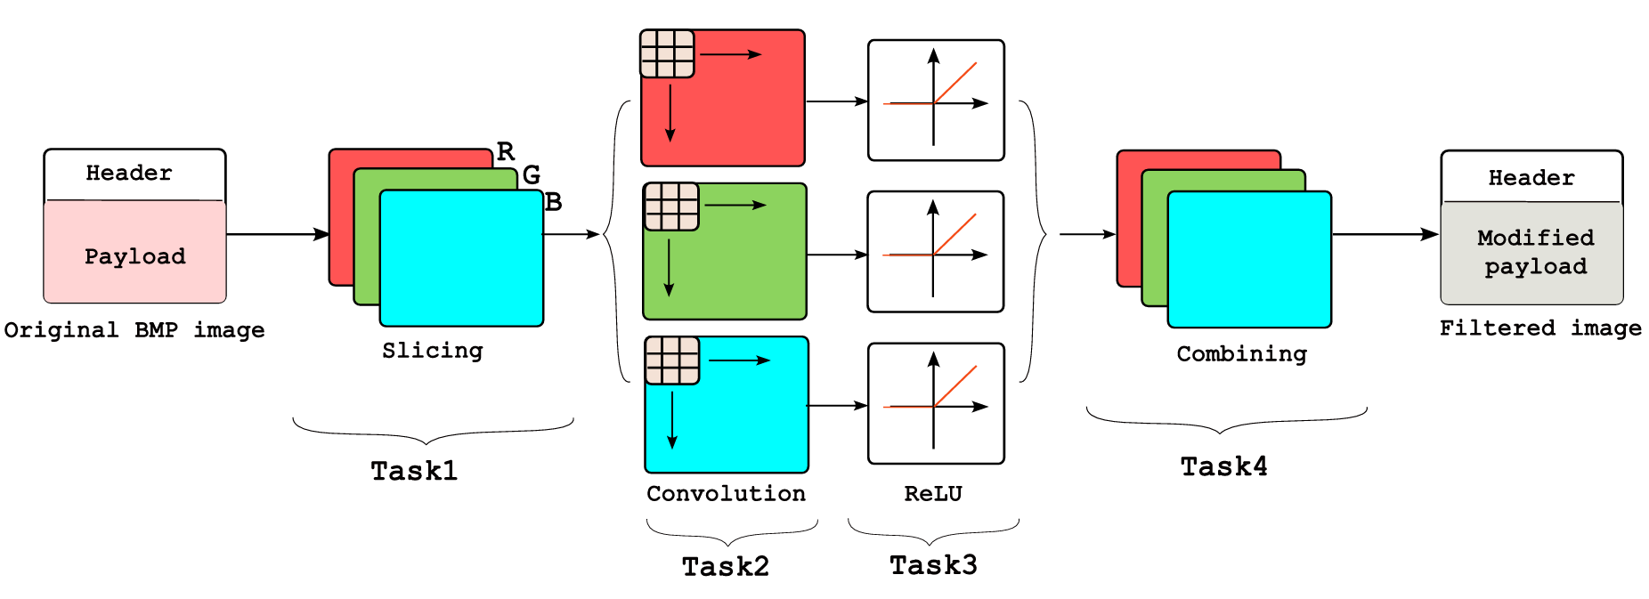
Expected behavıour

Slide 3
Used structs
typedef uint8_t BYTE;
typedef uint32_t DWORD;
typedef int32_t LONG;
typedef uint16_t WORD;
typedef struct
{
DWORD biSize;
LONG biWidth;
LONG biHeight;
WORD biPlanes;
WORD biBitCount;
DWORD biCompression;
DWORD biSizeImage;
LONG biXPelsPerMeter;
LONG biYPelsPerMeter;
DWORD biClrUsed;
DWORD biClrImportant;
} _attribute__((__packed__))
BITMAPINFOHEADER;
typedef struct
{
BYTE rgbtBlue;
BYTE rgbtGreen;
BYTE rgbtRed;
} _attribute__((__packed__))
RGBTRIPLE;
typedef struct
{
WORD bfType;
DWORD bfSize;
WORD bfReserved1;
WORD bfReserved2;
DWORD bfOffBits;
} _attribute__((__packed__))
BITMAPFILEHEADER;
typedef struct {
int height;
int width;
BYTE(*temp)[512];
int startW;
int startH;
int endW;
int endH;
}__attribute__((__packed__))
PIXELTHREADARGS;

Slide 4
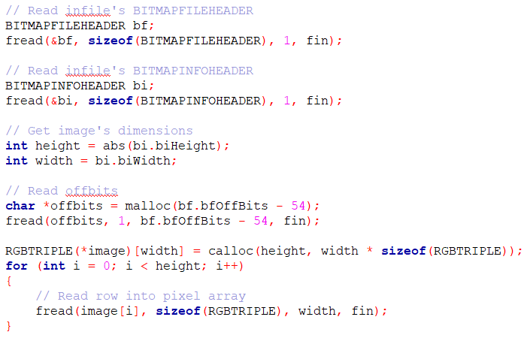
Readıng orıgınal ımage
BITMAPFILEHEADER-14
BITMAPINFOHEADER-40
OFFBITS
PIXEL ARRAY

Slide 5
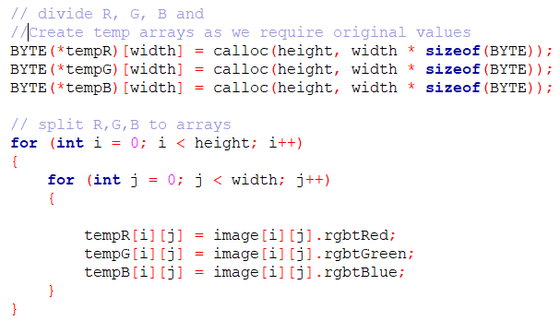
TASK 1 : slıcıng
RGB
R
G
B

Slide 6
TASK 1 : slıcıng
1
2
3
1
4
5
6
1 THREAD
6 THREAD
1
2
3
1
2
5
6
9
10
3
4
7
8
11
2
3 THREAD
12 THREAD
NOTE : For this image(lena.bmp) i did not use the 9 thread. Because i cant divide it even pieces.

Slide 7
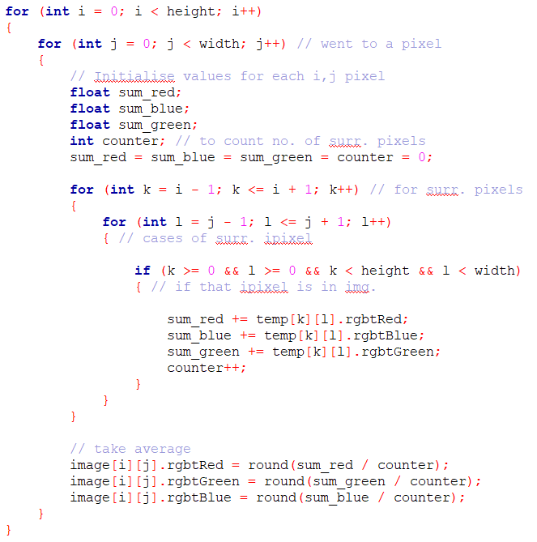

TASK 2 : convolutıon
$$\frac{1}{9}\left[\begin{matrix}1 & 1 & 1 \\ 1 & 1 & 1 \\ 1 & 1 & 1\end{matrix}\right]$$
Box Blur Kernel
Without Threading

Slide 8
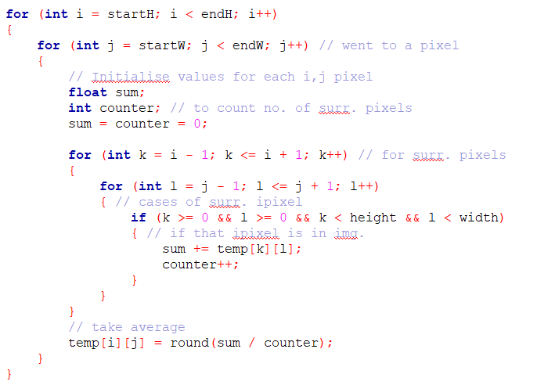
TASK 2 : convolutıon
$$\frac{1}{9}\left[\begin{matrix}1 & 1 & 1 \\ 1 & 1 & 1 \\ 1 & 1 & 1\end{matrix}\right]$$
Box Blur Kernel
With Threading

Slide 9
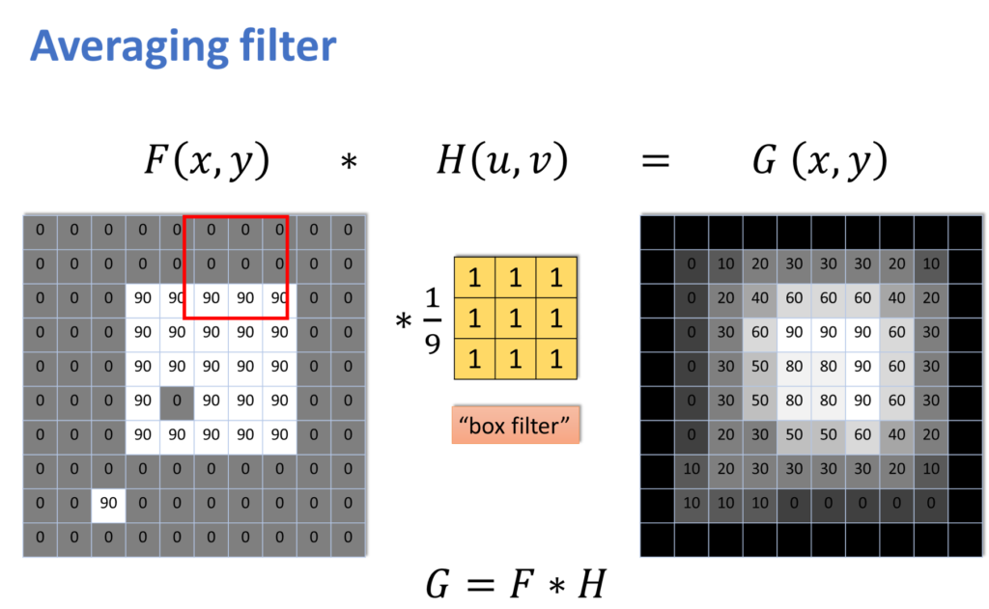
TASK 3 : RELU
$$\frac{1}{9}\left[\begin{matrix}1 & 1 & 1 \\ 1 & 1 & 1 \\ 1 & 1 & 1\end{matrix}\right]$$
In our kernel there is no negative value.
Because of the kernel type there is no need to use RELU.
Box Blur Kernel

Slide 10
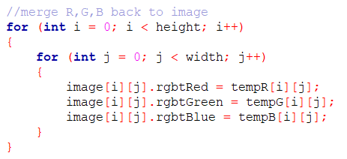
TASK 4 : combınıng
RGB
R
G
B

Slide 11
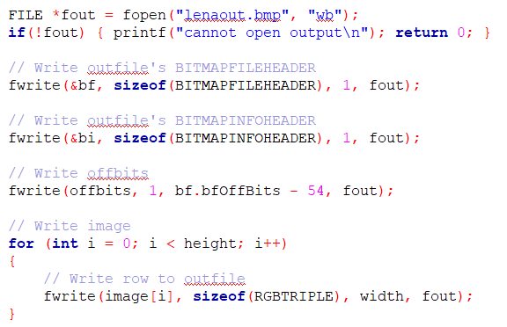
Wrıtıng Fıltered ımage
BITMAPFILEHEADER-14
BITMAPINFOHEADER-40
OFFBITS
PIXEL ARRAY

Slide 12
conclusıons

Slide 13
conclusıons

Slide 14
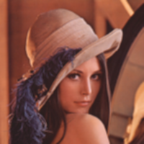

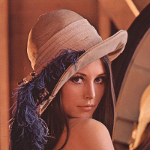


conclusıons
1 Thread
3 Thread
6 Thread
12 Thread

Slide 15
Thank you!
Any question?
Github link for Project files and result images :
https://github.com/debruw/SWE507-Project1.git

